Slide 1
CAB i zawm theuh ang u
By SPO (RCH) NHM & State SBCC Consultant UNICEF MIZORAM

Slide 2
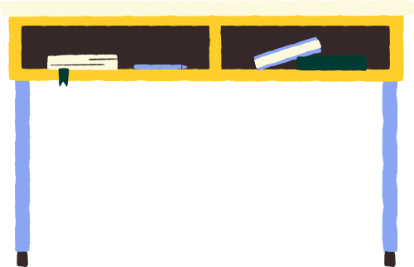
Chibai ule! COVID-19- leh COVID- Appropriate Behaviour (CAB) chungchang ilo sawi ho ang u.

Slide 3
Introduction
COVID-19 hi virus vanga damlohna/natna ani a, he virus hi coronavirus family ami a ni. He virus hi kum 2020 – 2021 a khawvel puma pandemic thlentu a ni.
Pandemic chu khawvel puma natna leng vel naupang atanga kum upa lam thlenga harsatna thlentu sawina a ni
Coronavirus hi pawnah anmahniin an dam rei thei lova, a pu kualtu mihring an ngai a ni
Hnar, ka leh a chang chuan mit kal tlangin kan taksa ah a lut thin
He virus hi kan taksa chhunga a luhin kan damlo thin a ni

Slide 4
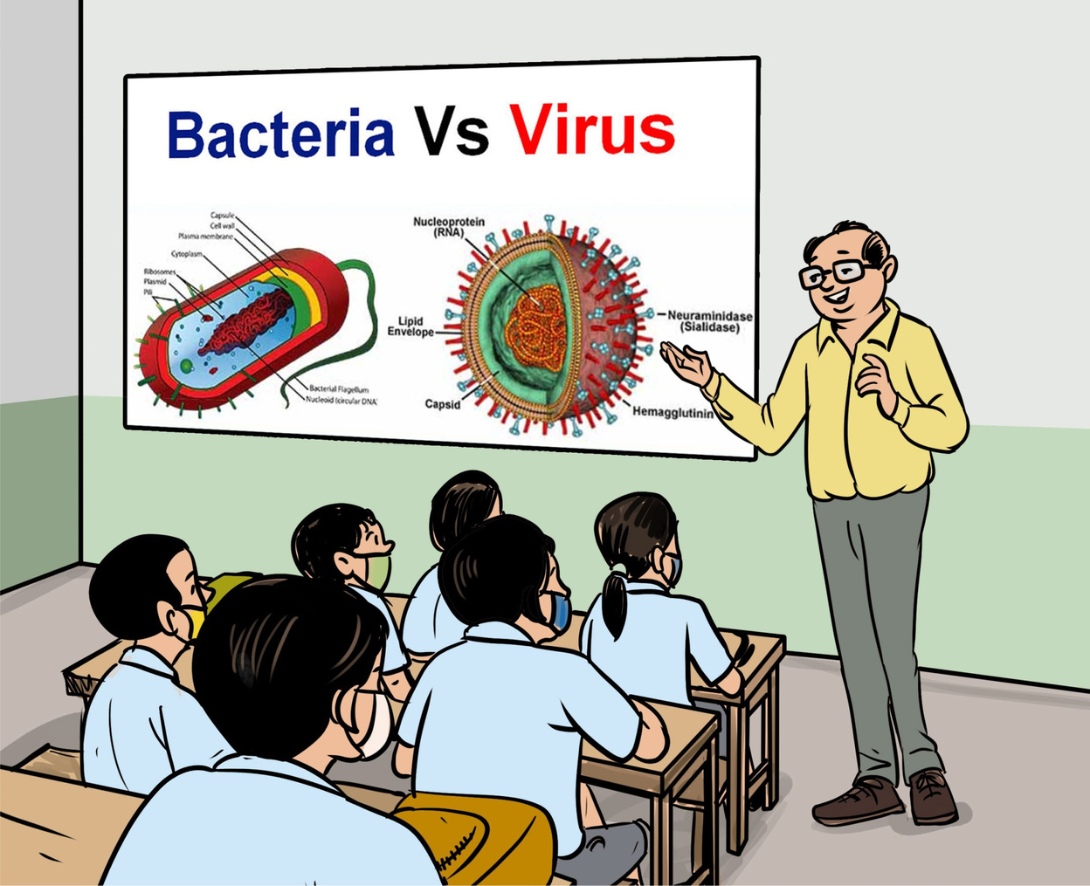
Introduction Contd
Kan taksa chhunga hri a luhin
Kan immune system hian virus tam tak lakah min veng thin a, amaherawh chu he virus hi a thar a nih avangin kan immune system chuan a paih chhuak mai thei lo.
Hei vang hian mihring kan damlo thin
Mihring thenkhatah chuan he virus pai chung si hian natna a lang chhuak lo thin
Naupangte paw’n puitling leh kum upa lam te kan kai chhawng thei
Tun thlengin hemi hri that tur hian damdawi a la awm lo
Hri kai an tam deuh changin, midang kan inkaichhawn zel loh nan school hi khar lailawk thin a ni

Slide 5
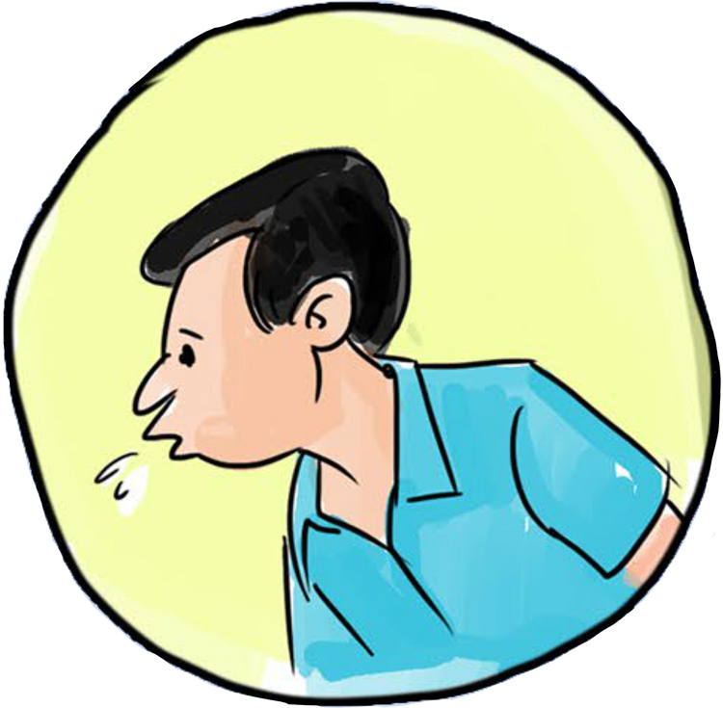
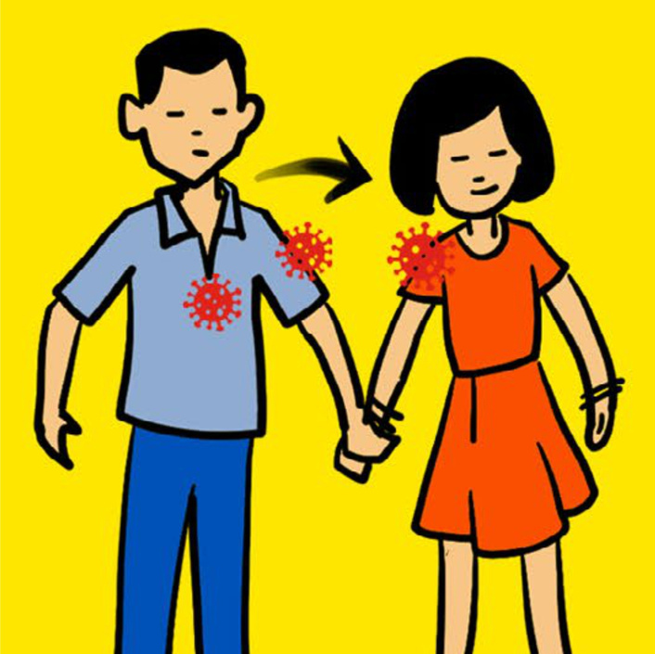
Hri inkai chhawn dan
Pahnihna
Mi an khuh emaw an hahchhiauin, an taksa atanga chhuak droplet huh chu dawhkan, thuthleng, toys, kawngkhar vawnna etc. ah te a kai thin.
Pakhatna
Pathumna
Mi an khuh emaw an hahchhiau in, an taksa atanga chhuak droplet sin te boruak ah rei tak a cham thin, a bik takin room phui ah te a cham rei zual
Hri vei mek te nena in hnimhnaih emaw hri vei mek te thil khawih hnu te khawih chuan hri a kai ve theih.

Slide 6
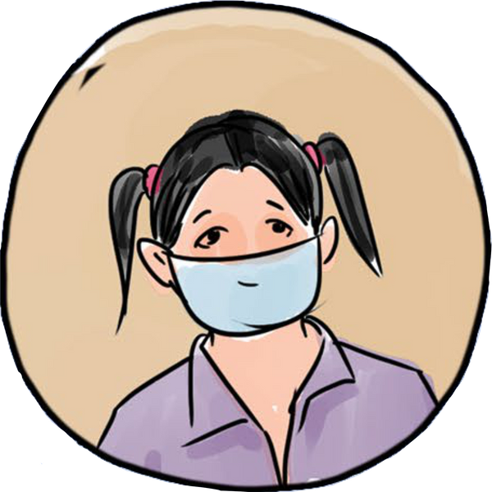
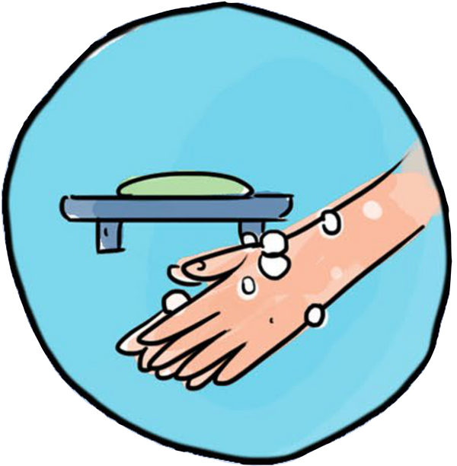
Golden Rules to Fight Against Corona
I Superpower pakhatna
Pawn chhuahin mask vuah rawh.
I superpower pahnihna
Pawn chhuah hnua inchhung luh leh veleh i kut kha second 20 chhung tal sahbawn nen uluk taka silfai tur.
I Superpower pathumna
A khat tawkin Sanitizer hmangin i kut bawr zawng ti fai thin rawh.

Slide 7
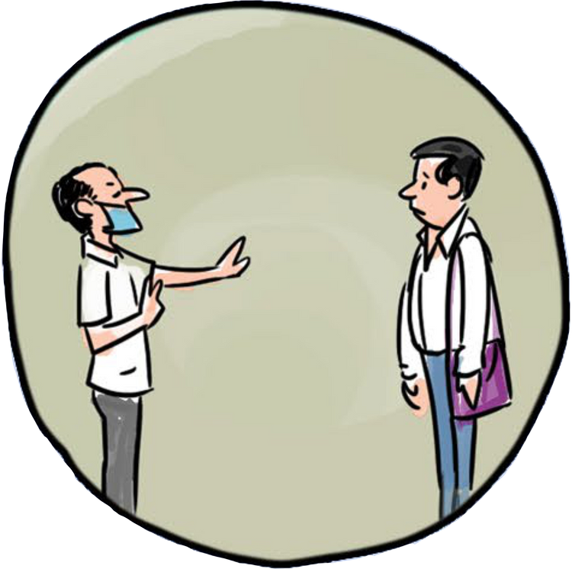
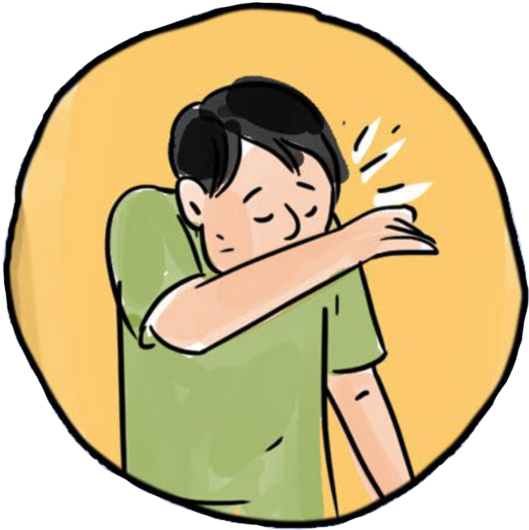
Hygiene Rules
Tih loh tur te
I mask vuah lai khawih khawih loh tur.
Kut sil fai hma chuan i hmai, i hnar, i mit te khawih loh tur.
Tiffin, tui bottle, handkerchief te intawm loh tur, inkuah leh inchibai loh tur.
Tih tur te
I mask in i hnar leh i ka a khuh ngei tur a ni.
Midang nen feet ruk tala inhlata awm hram tur.
I khuh emaw hahchhiauin i hmui leh hnar i banin khuh rawh.
Taksa nawmlohna i neih chuan i chhungte emaw in zirtirtu te hrilh vat tur.

Slide 8
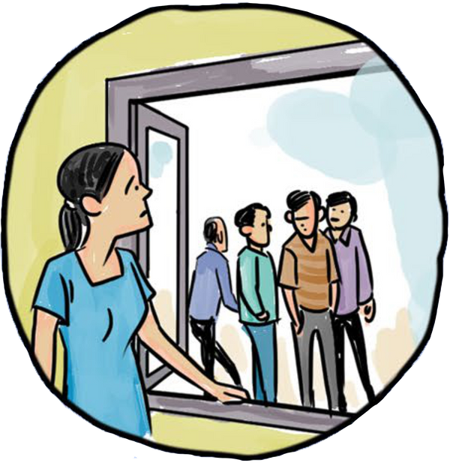
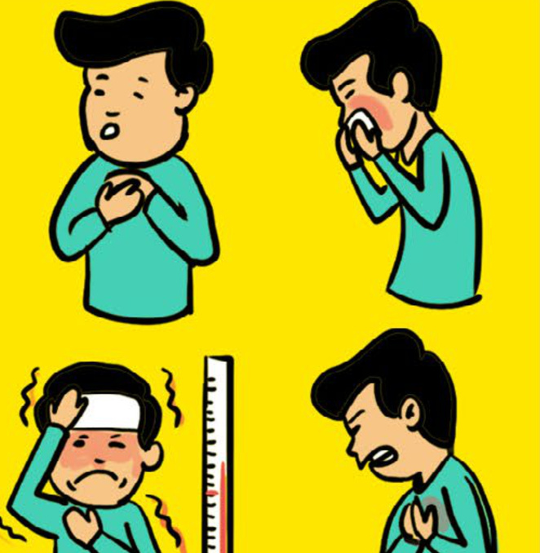
Indoor Rules
Tih loh tur te
Pawn chhuah leh thenawm te nena inpawh tam loh tur.
Hrawk thip, khuh, khawsik leh thawk harsatna nei te hnaih loh tur.
Mi infiamna khawih loh tur.
Thiante nena inkawm leh intihhlimna hun te neih loh tur.
Tih tur te
I unau te nen inchhungah infiam thin rawh.
I chhung te leh i ngaihpawimawh dangte nen phone leh video call a inbiak fo tur.
Bazara i kalin Social Distancing vawng reng rawh .
Taksa nawmlohna i nei a nih chuan i unau te leh i pi leh pu te bul hnaiah awm loh tur.
Hri lak atanga in him zawk nan inchhungah awm tam ang che.

Slide 9
Ka Lawm e!
Zawhna i neih chuan zawt rawh le!
Hriat chian duh i neih chuan zawt mai la a tha awm e.

Slide 10
Notable People and Their Contributions
Dr Lily Chhakchhuak, SPO (RCH) NHM Mizoram
Developed the idea of creating an advocacy for children towards Covid-appropriate Behaviour
Dr Aribam Rebecca Sharma, State SBCC Consultant,
(UNICEF) Mizoram
Came up with the idea of developing an advocacy for children on Covid-appropriate Behaviour, and created and canvassed the presentation to emphasize the idea
Naresh Meetei, Artist & Designer
Adapted illustrations from the comic book Flying Kites New Normal, in
collaboration with State SBCC Consultant, UNICEF

Slide 11
References
01
Kiting High New Normal for Children, by a collaborative initiative of Dr Anamika Ray Memorial Trust, Sarva Shiksha Abhiyan - Assam & UNICEF Assam (Comic book).
02
Modes of Transmission of virus causing COVID-19: implications for IPC recommendations, by WHO (Report).
03
‘Indoor play ideas to stimulate young children at home’, by UNICEF (Article).
04
What is the Coronavirus? Prevention and Advice for Kids - COVID-19, by Smile & Learn - English (YouTube Video)
05
The Coronavirus Explains to Children, by Eurac Research (YouTube Video)
06
5 Tips Kids need to know about COVID-19, by John Hopkins Medicine (YouTube Video).

